Slide 1
NLP Use case to analyze Social Media data for Spinal Muscular Atrophy (SMA)
Topics covered
Analyze Social Media data (Twitter Data) to understand Sentiment regarding Spinal Muscular Atrophy(SMA)
Data Mining of Twitter Data
Sentiment Analysis and Model Building
Topic Modeling
LDA visualized using t-SNE and Bokeh
Rudra Narayan Chand

Slide 2
Methods Adopted
Data extraction
Go to https://apps.twitter.com
Register using Twitter Account
Create your App and try to get consumer_key, consumer_secret, access_token and access_token_secret which will be used to pull the data using Tweepy library which is an official way of pulling the data

Slide 3
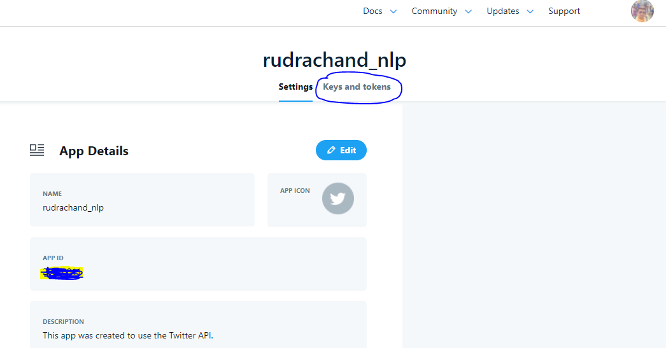
Twitter App

Slide 4
Text pre processing
Data Clean
There are sequence of activities are followed
Tokenization, Lemmatization, stop words
convert words in to vectors(bag of words, TFIDF,Unigram,Bigram,nGrams)
Text preprocessing
Exploratory Data Analysis
Visualizations (finding Top words, Top organizations for crowd sourcing, Top people who are involved)
Word Cloud
Sentiment Bar Chart
Model Building
Topic Modeling
LDA visualized using t-SNE and Bokeh

Slide 5
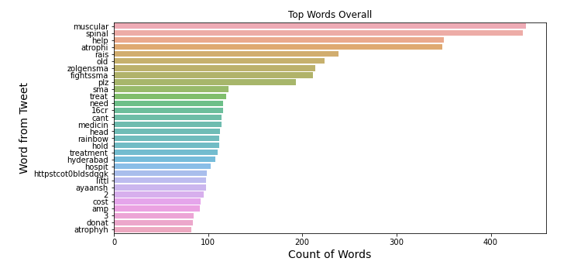
Most Frequent words

Slide 6
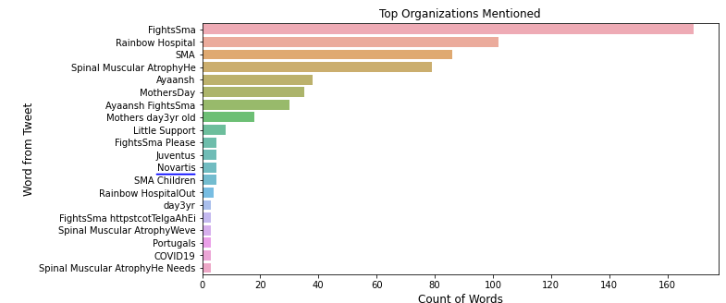
Top organizations involved in SMA

Slide 7
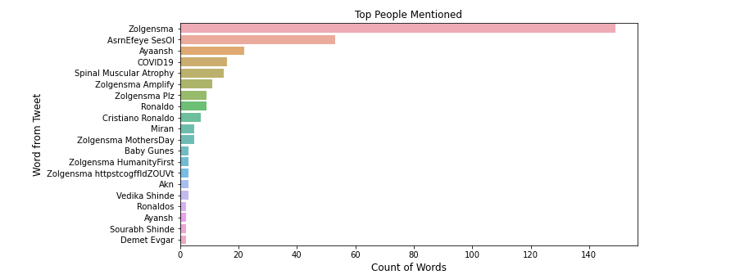
Methods Adopted

Slide 8
Methods Adopted
From Data Mining python scripts , tweeter.csv file is saved to the destination folder which is used further for Topic Modeling and Clustering purpose
Sentiment Bar Chart
Word Cloud Viz follows..

Slide 9
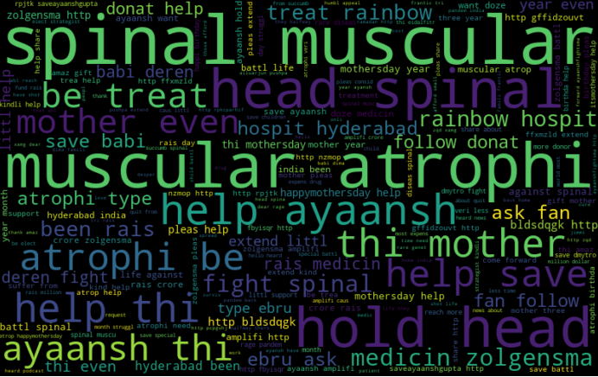
+ve Sentiment Word Cloud

Slide 10
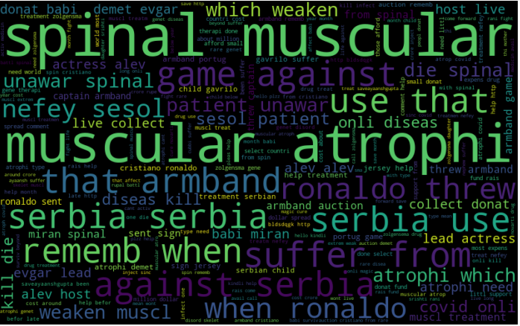
-ve Sentiment Word cloud

Slide 11
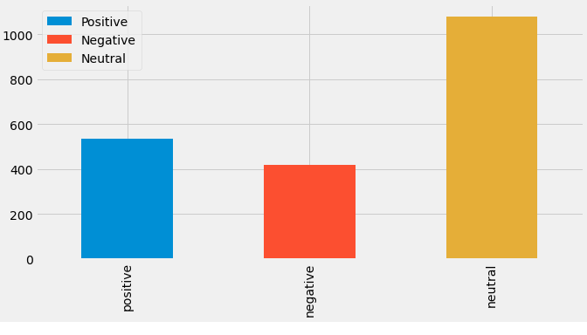
Sentiment Analysis Distributions

Slide 12
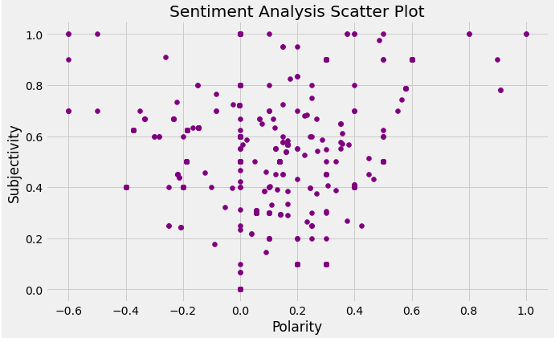
Scatter Plot

Slide 13
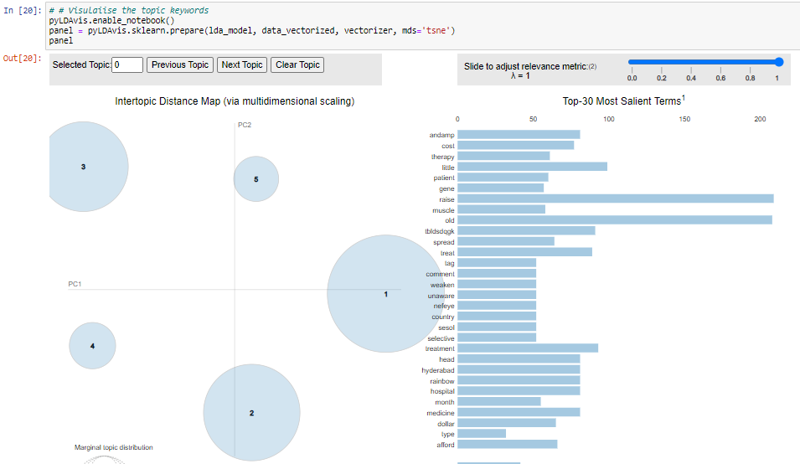
Topic Modeling

Slide 14
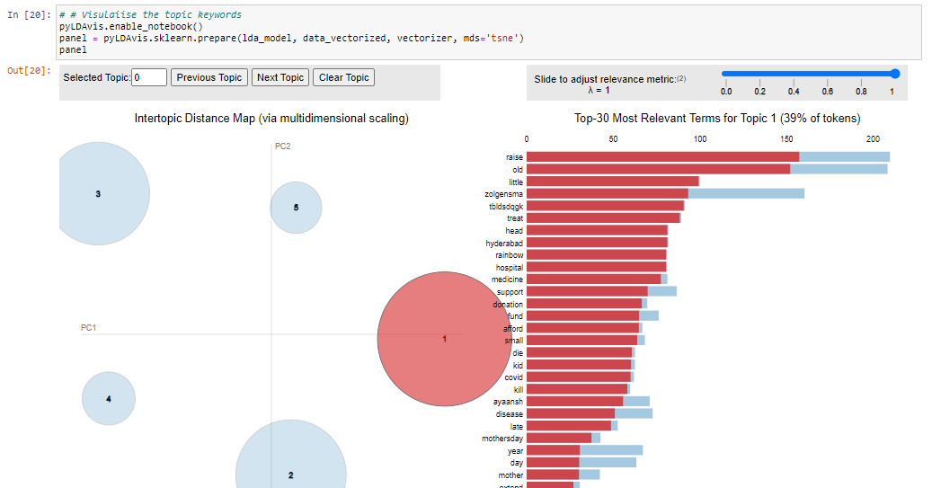
Topic Modeling

Slide 15
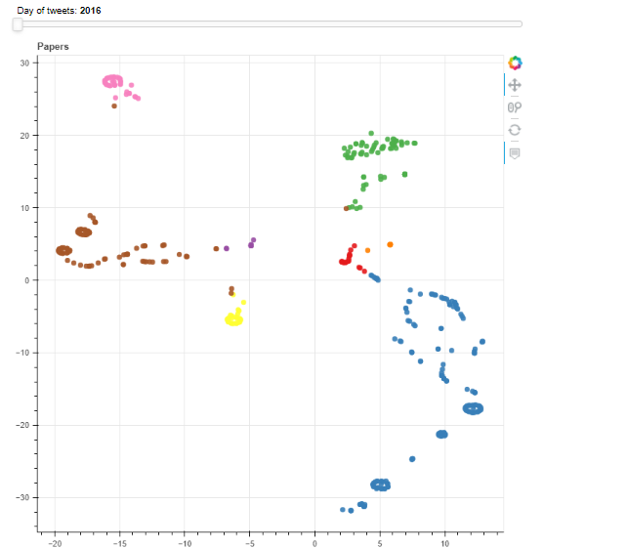
Cluster Analysis using tSNE

Slide 16
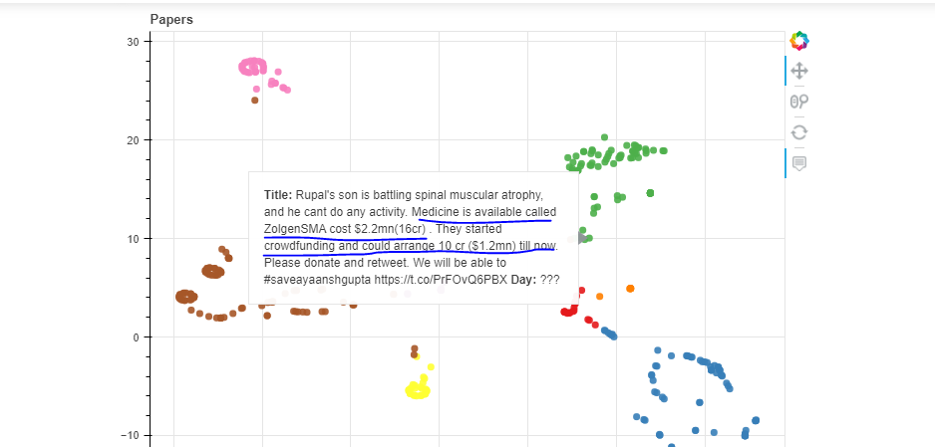
Cluster Analysis using tSNE with Bokeh

Slide 17
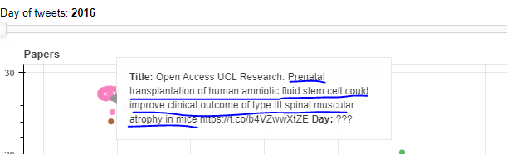
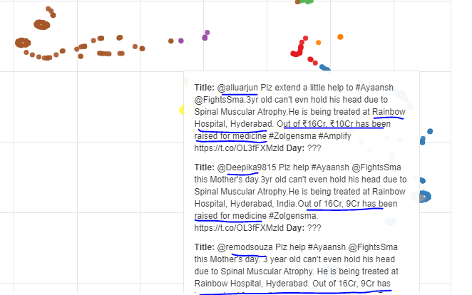
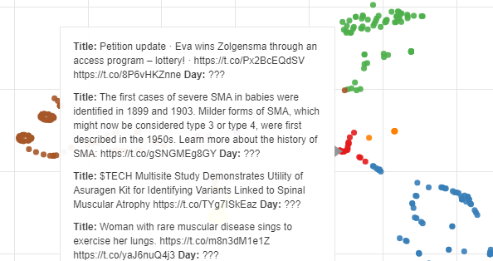
Cluster Analysis using tSNE with Bokeh

Slide 18
Some Findings
Spinal Muscular Atrophy (SMA) is a group of genetic disorders in which a person cannot control the movement of their muscles due to a loss of nerve cells in the spinal cord and brain stem. It is a neurological condition and a type of motor neuron disease
Medicine available called ZologenSMA which is world’s most expensive drug manufactures by Novartis ..
Prenatal transplantation of human amniotic fluid stem cell could improve clinical outcome of type III SMA in mice
Some of the big hospitals like Rainbow hospital Hyderabad which are engaged for SMA treatment specially for kids
Some people who are donating for the novel cause which are crowd funded for treatment of SMA are Christano Ronaldo,Juventos and some movie celebrities has been requested to donate thru social media

Slide 19
Sorce Code
Only Twitter data has been extracted and analyzed and due to lack of time it was not possible to scrape data from Linked in and Online News channels
Source Code has been attached as ipython notebook
Python programming and NLP techniques has been used to do so..
Model has been built with binary classification of sentiment label 0:”positive” and 1:”negative” with accuracy 96%
Api keys has been masked and given as I am using my twitter account credentials
consumer_key = "XXXXXXXXX"
consumer_secret = "XXXXXXXX"
access_token = "XXXXXXXX"
access_token_secret = "XXXXXXXX"

Slide 20
Thank you
Rudra Narayan Chand

